Slide 1

Arose Agriculture services

Slide 2
Our Mission
We are developing a Website and application for Indian Farmers
This platform is mainly developed by keeping in mind all the troubles encountered by a farmer throughout the crop lifecycle starting from sowing seed to selling the end product in market.
Our technology plays very crucial role in Agriculture chain system by filling the gaps

Slide 3
Agriculture Chain system
Land
Companies
Farmer
Buyers
Labours
Seller

Slide 4
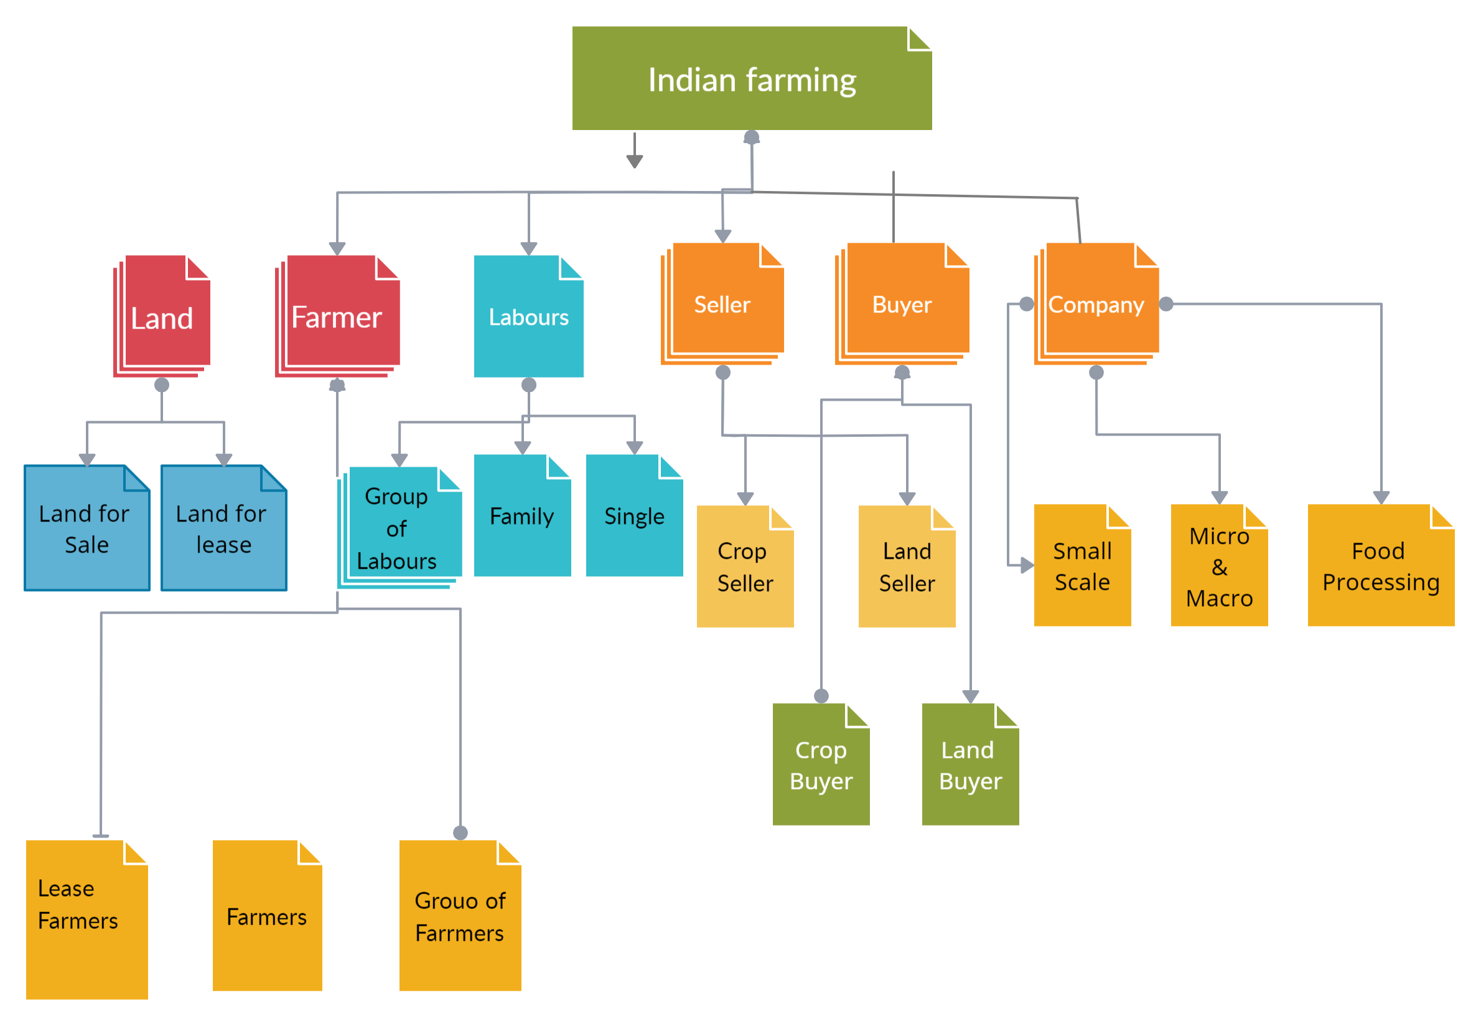
Chain system Elaborated

Slide 5
Home Page
Details about work
Select languages
User name
Password

Slide 6
Services – Centre points – Careers – Documentation work – Videos - Insurance

Slide 7
Services
Crop Seller – Crop Buyer
Land lease – Land taker
Agriculture land seller – Buyer
Tenders
Labours
Nursery's
Animal Husbandry
Financial supporters

Slide 8
Crop Seller – Crop Buyer
Location - State- District – Mandal – CenterPoint
Crop Seller – Fruits - vegetables – cereals – grains - commercial crops-poultry-aqua
Crop Buyers - Fruits - vegetables – cereals – grains - commercial crops-poultry-aqua
SMS/Notification
Post by seller SMS/Notification Buyer

Slide 9
Land lease – Land taker
Location - State- District – Mandal – CenterPoint
Land lease giver - land-poultry sheds-aqua ponds-diary form, Barren, Vermicompost shed
Land lease taker - land-poultry sheds-aqua ponds-diary form, Barren, Vermicompost shed
Post by land lease giver -→ SMS Notification → Land lease taker
Reverse of above

Slide 10
Agriculture land seller – Buyer
Location - State- District – Mandal – CenterPoint
Land seller – land without crop -poultry sheds-aqua ponds-diary form, Barren, Vermicompost shed, Land with crop
Land buyer – land without crop -poultry sheds-aqua ponds-diary form, Barren, Vermicompost shed , Land with crop
Land seller → SMS notification → Land buyer
Reverse of the above

Slide 11
Tenders
Location - State- District – Mandal – CenterPoint
A group of farmers → Companies → Buyers
Group of 10 members, 20 members, 30 members, 50 members etc
Land – 10 Acres, 20 Acres, 40 Acres, 50 Acres, 100 Acres etc
Tender by company/buyer → Group of farmers

Slide 12
Labours
Location - State- District – Mandal – CenterPoint
Group of labours or Family or Single labour
Farmers → SMS → Group of labours or Family or Single labour

Slide 13
Nursery's
Location - State- District – Mandal – CenterPoint
Farmer → Nursery

Slide 14
Animal Husbandry
Location - State- District – Mandal – CenterPoint
Buyer & Seller
Buyers – Goats, Sheeps, Buffalos, Cows, OX’s, Hens, Cocks, Rabbits, Emu, Pigs
Seller - Goats, Sheeps, Buffalos, Cows, OX’s, Hens, Cocks, Rabbits, Emu, Pigs
Buyer → SMS → Seller
Reverse of the above

Slide 15
Financial supporters
Location - State- District – Mandal – CenterPoint
Financial support takers & Financial support givers
Financial support giver → Crop growth, Aqua, Dairy, Nursery, Poultry, Vermicompost, Farms, Barren, Nursery's
Financial support taker → Crop growth, Aqua, Dairy, Nursery, Poultry, Vermicompost, Farms, Barren, Nursery’s
Financial support giver → SMS → Financial support taker
Reverse of the above

Slide 16
Look and feel of Home Page – Arose agriculture services
Services
Tenders
Centre points
Careers
Insurance
Financial Supporters

Slide 17
Services
Crop Lease
Crop Buyer
Crop Seller
Agriculture Land lease
Agriculture Land sale
Labours

Slide 18
Crop Lease
Location selection State - District – Mandal – CenterPoint
Crop selection Fruits – Commercial crops
Registration Process Farmer will register on our website with the help of center points by giving all the required data like
Appearance on web site
Crop name: Palm oil
Type of lease: yearly
Lease Years: 3 years
Center available: Malkaram
Acers:5 Acer’s
Amount: four lakhs fifty thousand rupees
Description: write the matter as notes which is not included in the format
Photos:
Center mobile number: XXXXXXXXXX

Slide 19
Data need to be enclosed by farmer for crop lease
Name of the farmer: konusothu Ravi
Address of the farmer: Malkaram village, Dammapeta mandal, bhadradri kothagudem DT, pin507306. Telangana.
Aadhar card no:887755664433
Location of the crop: Lachapuram
Acer’s: 5 Acer’s
Crop: Palm oil
Lease type: crop growth or Crop yield
Lease year’s: 5 year’s
Water sources: bore well, Pump set, Canal, River, Lake, Pond
Drip irrigation type: write hear
Cost expect for 1 Acer: thirty thousand one lakh fifty thousand rupees per annum
Total cost: seven lakhs fifty thousand rupees only Payment method: year wise
Payment method: Half amount before lease or Half amount middle of the lease years or Year wise
Mobile number:657543224
Bank details of the farmer: basic on need
Upload pictures: description matter to write

Slide 20
Crop Buyers
Location selection State - District – Mandal – CenterPoint
Crop selection Fruits – Cereals – Dairy farm – Poultry- Aqua pond – Grains – Commercial crops
Registration Process Farmer will register on our website with the help of center points by giving all the required data like
Appearance on web site
Required crop name: Palm oil
Required amount of crop
Bag Quantity
Cost of Quantity
Contact center

Slide 21
Data need to be enclosed by crop buyer for registration
Name of the buyer:
Crop buyer I’d:
Name of the company:
Company registration no:
Address:
Phone number:
Aadhar card:
Crop name:
Required quantity:
Bag quantity:
Quality:
Quality based amount:
Cost:
Payment method:
Transportation:
Transportation payment:
Empty bags cost:
Labour cost:

Slide 22
Crop Seller
Location selection State - District – Mandal – CenterPoint
Crop selection Fruits – Cereals – Grains - Dairy farm – Poultry- Aqua pond – Commercial crops
Registration Process Farmer will register on our website with the help of center points by giving all the required data like
Appearance on web site
Name of the crop
Quality
Quantity
Contact center

Slide 23
Data need to be enclosed by crop seller for registration
Appearance on web site
Name of the farmer
Address
Phone number
Aadhar number
Name of crop
Acer’s of Land cultivated
Quality
Quantity
Land Mark

Slide 24
Agriculture land lease
Location selection State - District – Mandal – CenterPoint
Crop selection Land – Poultry sheds – Aqua ponds – Dairy farm
Registration Process Farmer will register on our website with the help of center points by giving all the required data like
Appearance on web site:
Name of the farmer:
Land type:
Acer’s:
Cost per Acer:
Time period:
Total amount:
Contact Center Mobile number:

Slide 25
Data need to be enclosed for agriculture land lease registration
Name of the land owner:
Address:
Mobile number:
Aadhar number:
Land Mark:
Acer’s:
Cost per Acer:
Time period:
Total amount:
Soil type: black, Red, Light green Sand, Laterite, Stone soil
Preferred crops:
Water sources: Bore with Motor, Pump set, River, Canal, Lake, Pond, Rain
Motor facilities: 7 ½ horse power or 10 hp or 12 ½ hp
Climatic conditions:

Slide 26
Labours
Location selection State - District – Mandal – CenterPoint
Appearance on web site:
Labour group name:
Members:
Place:
Daily wage:
Contact basic:
Time period:
Place of work:
Center number:

Slide 27
Data need to be enclosed for labour registration
Labour’s group name:
Address:
Mobile number of group leader:
Daily wage:
Contract basis:
Members in a group:
Traveling places: preferred State:
Across India:
Policy:
Work preference:
Any work:
Estimated period of work:
Members adhere card proof’s:
No objection certificate:
Group photo:

Slide 28
Tenders
Location selection State - District – Mandal – CenterPoint
Appearance on website:
Appearance of farmers tenders on website
Farmers group name:
Land in Acer’s:
Crop specific:
Crop required
Center Contact number:
Appearance of buyers or company tenders on website
Name of the company:
Name of the buyer:
Acer’s:
Quantity of bag:
Quantity:
Quality:
Center Contact number:

Slide 29
Data need to be enclosed for Tenders
Name of the farmer’s group:
Farmers list in the group:
Aadhar cards:
Contact number
Insurance policy
Address:
Specific crop:
Required crop:
Total Acer’s
Water sources availability:
Season of crop:
Market rate:
Quality:
Quantity:

Slide 30
Agriculture land sale
Location selection State - District – Mandal – CenterPoint
Type of land Land - Diary farm - Poultry farm - Aqua pond
Appearance on website
Name of the farmer:
Acer’s:
Crop available:
Plain Field:
Water sources:
Current facilities:
Cost per Acer:
Total cost:

Slide 31
Data need to be enclosed for Agriculture land sale
Name of the land holder:
Address:
Acer’s:
Address:
Land details:
Soil type:
Water sources:
Transformer:
Current facilities:
Cost for Acer:
Market rate:
Contact number:
Nearest place to Land:
Land revenue:
Crop available:
Type of crop:
Drip irrigation:
Family members certificate:
Registration Land:
Pass book:
Patta Land:

Slide 32
Insurance Policy
We have designed unique insurance policies in place which will be given to all the farmers and labour’s who enroll with us and through which they will have security for their life, health and wealth.
Location selection State - District – Mandal – CenterPoint

Slide 33

Thank you

